Slide 1
Top 3 Diseases and Medications Analysis with Medical Corpus Using NLP
Notes:
Good afternoon, we are group 5. For our final project, we focus on exploring the common geriatric diseases and their corresponding medications.

Slide 2
Data
Database - MIMIC III (Medical Information Mart for Intensive Care III)
A large, single-center database of information related to patients admitted to critical care units at a large tertiary care hospital (by the MIT Lab for Computational Physiology)
Compared to other corpora: 1. freely available to researchers worldwide; 2. encompasses a diverse and very large population of ICU patients; 3. contains high temporal resolution data including lab results, electronic documentation, and bedside monitor trends and waveforms
Compared to MIMIC II: anticipated by its developers to be widely used internationally in areas such as academic and industrial research, quality improvement initiatives, and higher education coursework
Notes:
The corpus we used is MIMIC III (Medical Information Mart for Intensive Care III). It is a large, single-center database of information related to patients admitted to critical care units at a large tertiary care hospital. Data includes vital signs, medications, laboratory measurements, observations and notes charted by care providers, fluid balance, procedure codes, diagnostic codes, imaging reports, hospital length of stay, survival data, and more. It was developed by the MIT Lab for Computational Physiology. The measurement types of it contains data integration objectives such as demographics, clinical measurement, intervention, billing, and clinical laboratory test. It also has technology types, for what the data integration objectives contain electronic medical record and electronic billing system. Compared to other corpora, it has three notable features: it is freely available to researchers worldwide; it encompasses a diverse and very large population of ICU patients; and it contains high temporal resolution data including lab results, electronic documentation, and bedside monitor trends and waveforms. Compared to MIMIC II, its previous version, MIMIC-III is anticipated by its developers to be widely used internationally in areas such as academic and industrial research, quality improvement initiatives, and higher education coursework.

Slide 3
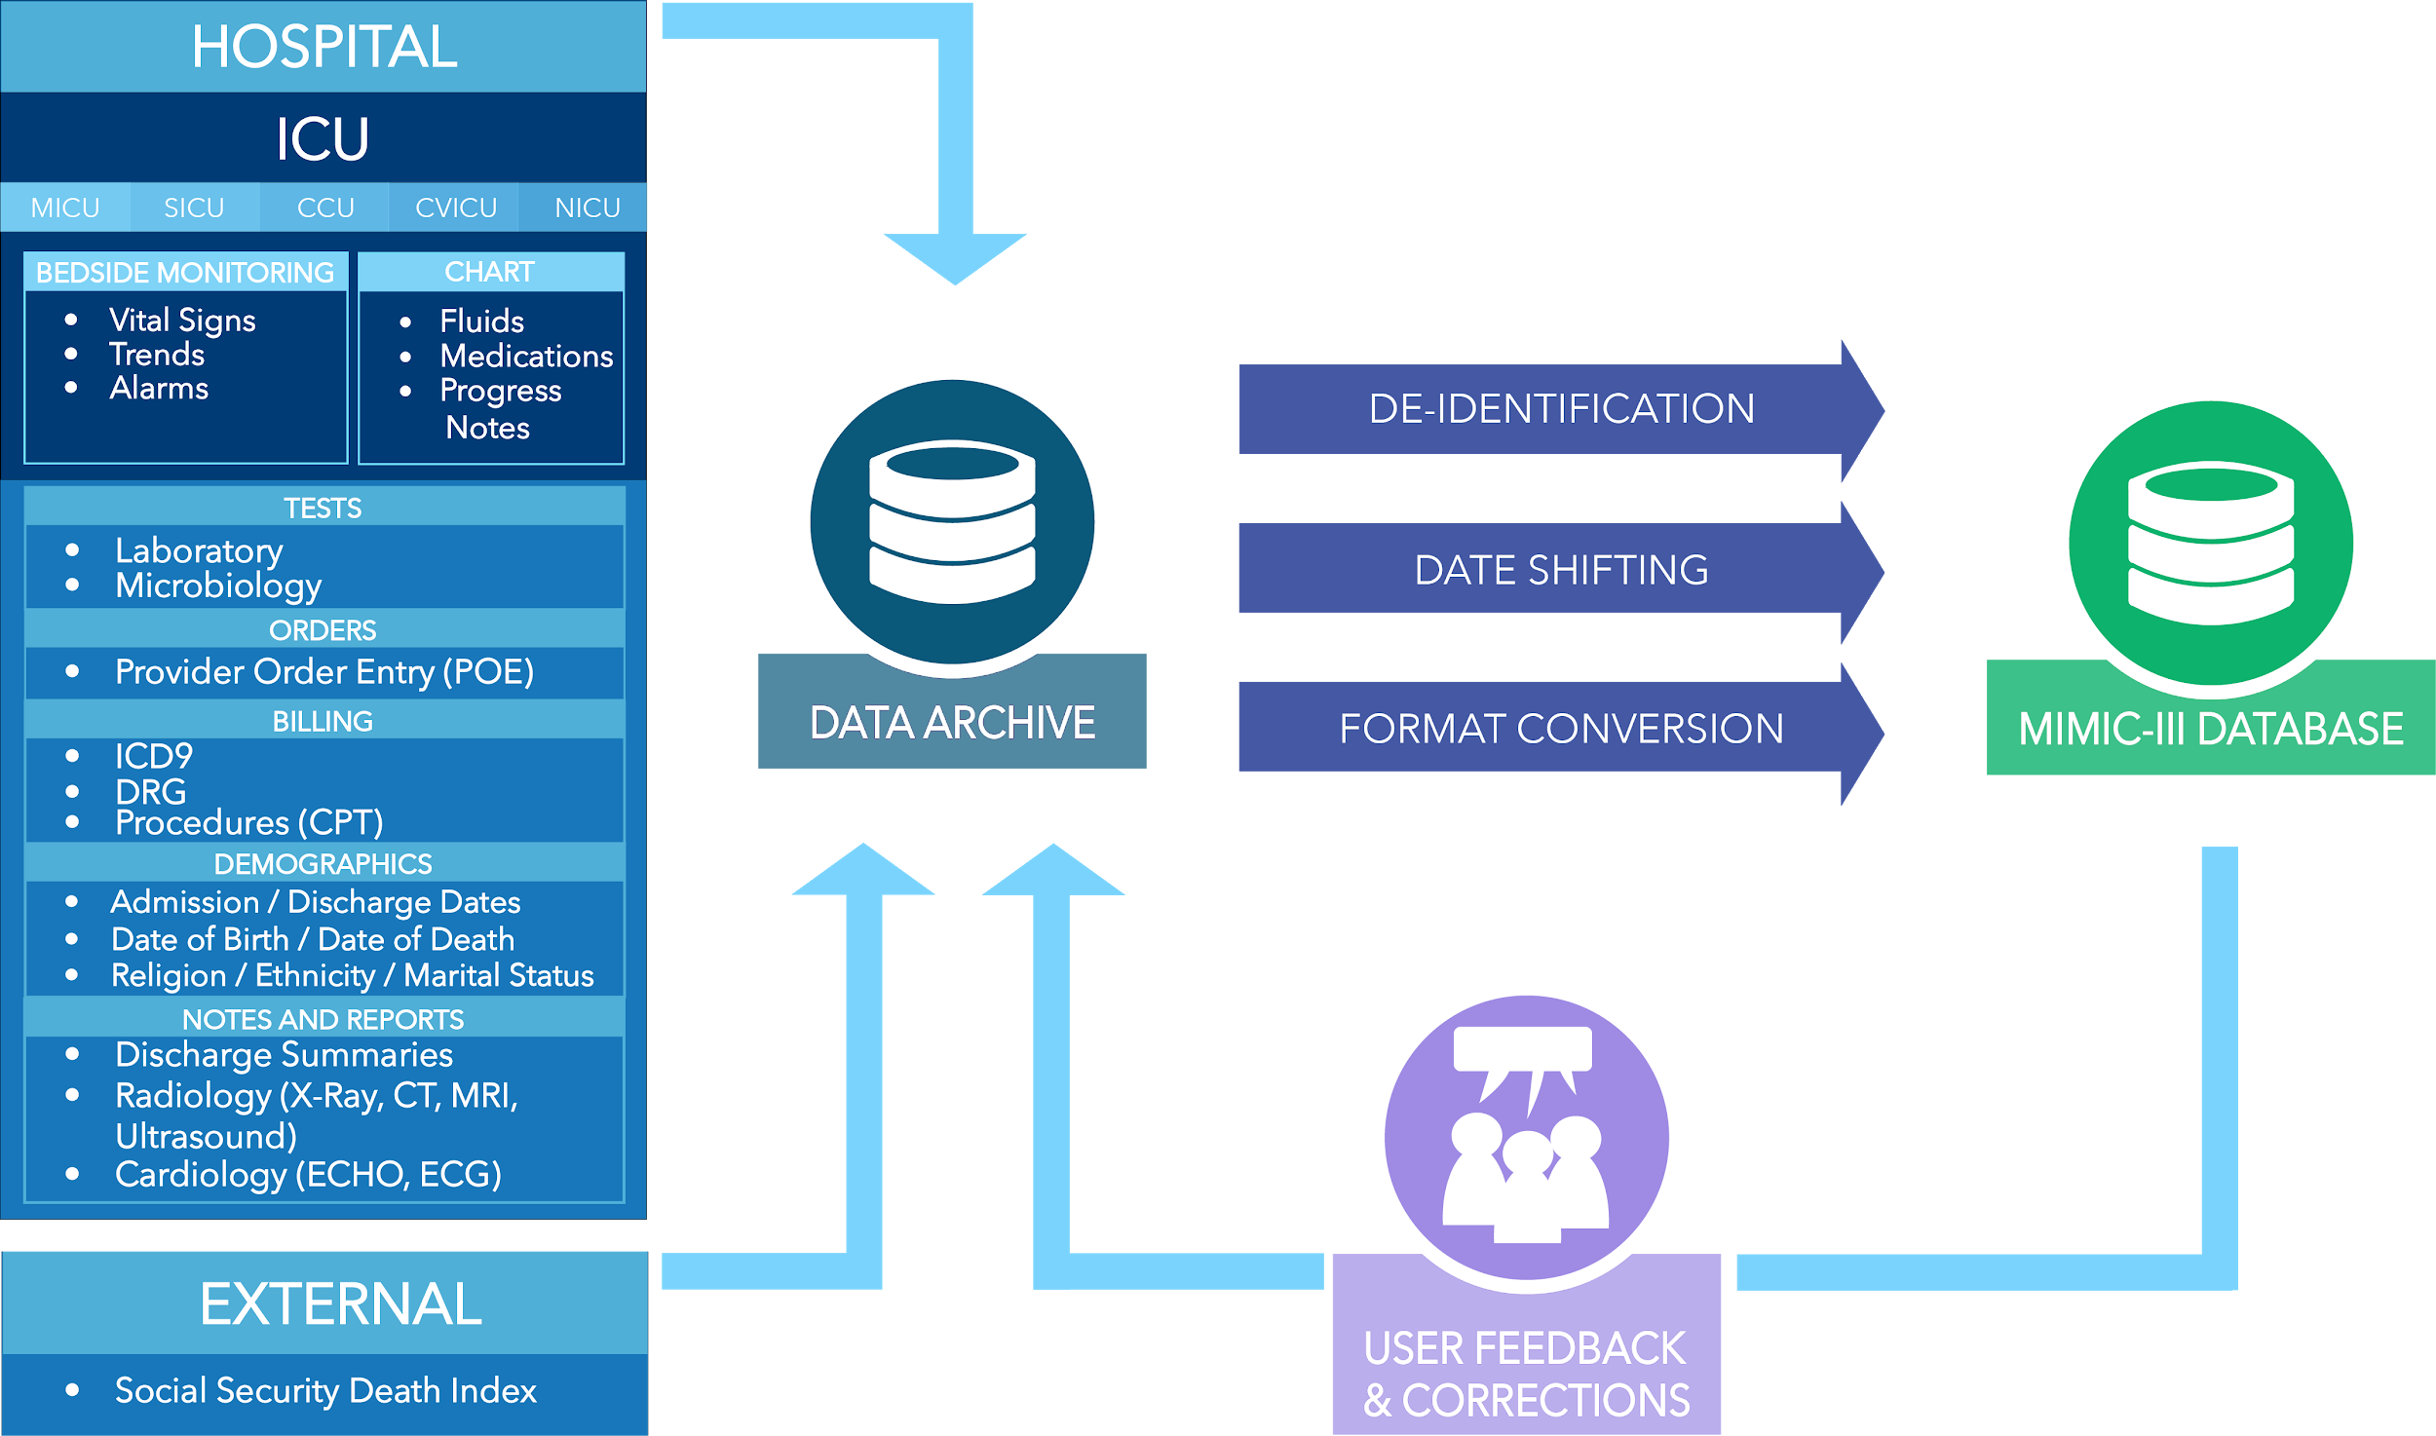
Notes:
Here shows how the MIMIC III database was created, and what kind of data it contains. For example, demographics, tests, orders, notes and reports.

Slide 4
Significance
Our scientific question contains two parts:
What are the top three diseases that cause elderly (65+) to go to hospitals?
What are the most common medications corresponding to those three geriatric diseases?
How it affects human health:
In the US, nearly 29% of the 46 million community-dwelling elderly live alone
This study objective may contribute to improving public awareness of the common geriatrics, daily preventions, and the preparation of common medications at home
Notes:
Our scientific question contains two parts: 1. What are the top three diseases that cause elderly (65+) to go to hospitals? 2. What are the most common medications corresponding to those three geriatric diseases? How it affects human health: Study found that the phenomenon of elderly people living alone exist. In the US, nearly 29% of the 46 million community-dwelling elderly live alone (Kaplan, Berkman and Fitzdale, 2016). Therefore, such a study objective of finding common geriatrics may contribute to improving public awareness of the common geriatrics, daily preventions, and the preparation of common medications at home

Slide 5
Rationale
Why we used this corpus:
MIMIC III has health-related data associated with approximately 60,000 admissions of patients → The sufficient information in this corpus allows us to extract enough clinical notes as our sample and find answers to our scientific question
MIMIC III was used as the underlying database for the study, A data-driven approach to optimized medication dosing: a focus on heparin
Notes:
Why using the corpus: MIMIC III has health-related data associated with approximately 60,000 admissions of patients. The sufficiency of the information in this corpus allows us to extract enough clinical notes as our sample and find answers to our scientific question. Reference of one or more papers: Because the MIMIC III was released in 2016, there are not so many studies or papers mentioning that the MIMIC III was used as the underlying dataset. However, a paper named A data-driven approach to optimized medication dosing: a focus on heparin mentioned that the data of this study was extracted from the MIMIC-II to select all patients who received heparin during their ICU stay (Ghassemi et al., 2018).

Slide 6
Main Method, Implementation, & Results
Generating Study Sample:
Our corpus is NoteEvents from MIMIC III, which is 4.01 GB in size. Clinical notes for 40,000 randomly selected patients are our sample.
Extracting geriatric patients (older than 65 years old) and Diagnosis and Medication Notes
Method: RegEx
Rationale or details of application: (in 40,000 notes, the results was around 9000 notes that fit our criteria of >65.)
Diagnoses = r"Discharge Diagnosis:(.*?)(?:(?:\r*\n){2})"

Slide 7
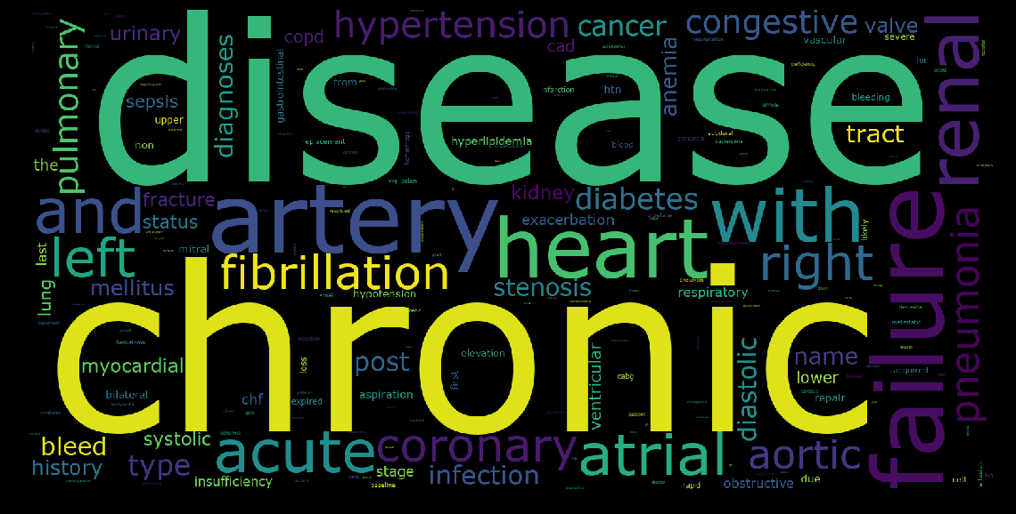
Notes:
Disease Wordcloud

Slide 8
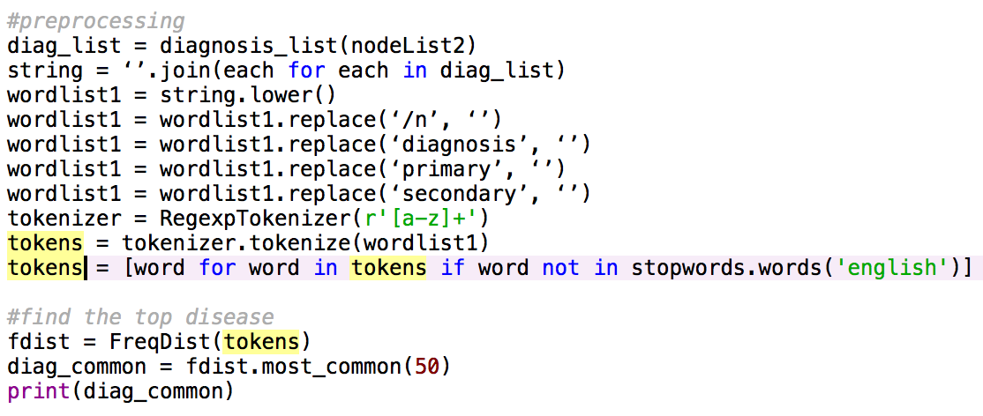
Main Method, Implementation, & Results
Preprocessed the diagnosis Notes:
Notes:
To find the top three diseases that cause elder people go to the hospital, we first preprocessed the diagnosis text we extracted in the previous step: like, lower the case, remove numbers, stop-words and punctuations. And then we ran a word frequency to get the list of diseases. Here shows our code to do this: We didn’t stem the words cause it may induce some bias to our results.

Slide 9
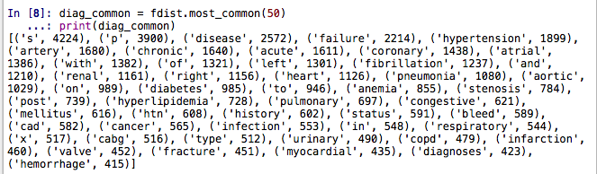
Main Method, Implementation, & Results
Word frequency on preprocessed diagnosis notes
Hypertension
Coronary Artery Disease
Atrial Fibrillation
Notes:
Here’s the output for the frequencies for all words in preprocessed diagnosis text. Then by recognizing the diseases manually, we got our results: the top three diseases having highest frequencies are hypertension, Coronary Artery disease, and atrial fibrillation.

Slide 10


Main Method, Implementation, & Results
Filtering the notes with top diseases
Coronary Artery Disease: 461 patients
Hypertension: 436 patients
Atrial Fibrillation: 389 patients
Notes:
We use these three diseases to filter original notes and found the number of patients who got thoses diseases. This step is to avoid the bias generated from the previous word frequency result. The difference is that Coronary Artery disease has more patients than hypertension. So we considered the Coronary Artery disease as our top one disease.

Slide 11
Main Method, Implementation, & Results
Word frequency on filtered medication notes
Coronary Artery Disease: Aspirin (184 word counts), Docusate Sodium (Docusate 136, Sodium 184), Metoprolol Tartrate (Metoprolol 143, Tartrate 120).
Atrial Fibrillation: the suggested medications are Metoprolol succinate (metoprolol has 124 word counts), Docusate sodium (docusate has 107 word counts, sodium has 150 word counts), and Metoprolol tartrate (tartrate has 105 word counts).
Hypertension: Aspirin (235), Metoprolol (173), HCl (136), Docusate (135)
Notes:
After getting these results, we extracted three medication text files of clinical records of the patients who had the top 3 diseases. Then we generated word frequency lists on each of them. Here’s the medication list associated with certain diseases. we manually compare the medications searched from other sources to the medications in frequency list. However, we still believe there’s some bias since each patient can have multiple diseases so there are some duplicated medications. but we treat this issue in the latter part.

Slide 12
Method 2: N-Gram
Some diseases name contains more than one word.
n-gram: a contiguous sequence of n items from a given sample of text or speech.
n-gram model: a type of probabilistic language model for predicting the next item in such a sequence in the form of a (n − 1)–order Markov model.
Notes:
As for diseases, using the previous method can only give us the counts of single word, but Some diseases name contains more than one word, so we use N-Gram to identify those multiple-word diseases.

Slide 13
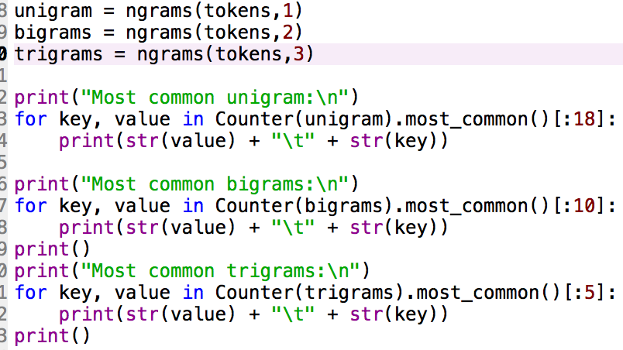
Implementation: N-Gram

Slide 14
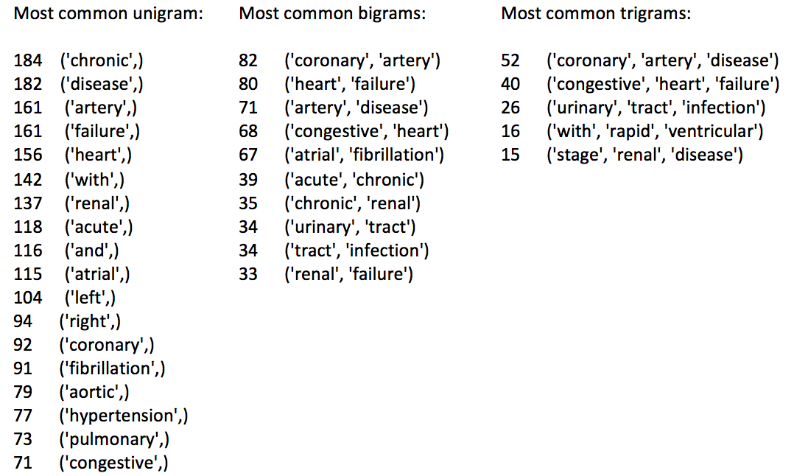
Results: N-Gram
Top three diseases:
Coronary Artery Disease
Hypertension
Atrial Fibrillation
Notes:
The result of most common unigram shows that the single-word disease is hypertension (77 counts), the bigrams indicate that the two-word diseases are coronary artery (82, in some notes it is the abbreviation for coronary artery disease) and atrial fibrillation (67). In the result of most common trigrams, the three-word diseases are coronary artery disease (52) and congestive heart failure (40). In conclusion, the top three diseases found by N-Gram method are coronary artery disease, hypertension and atrial fibrillation.

Slide 15
Method 3: TFIDF
Bind the top diagnosis and common treatments found
Calculate the TFIDF of each top medication for each diagnosis related papers.
Example: if the TFIDF of certain medication is significantly higher than it for other medication for Hypertension therapeutic papers, the medication could be classified as treatments for Hypertension
Additional corpus is pubmed for this method
Notes:
Another method to Bind the top diagnosis and common treatments found is to use TFIDF.
Because with frequency method, our potential problem is that each patient can have several diseases, so the relationship between disease & medication may be affected by several diseases the patient has.

Slide 16
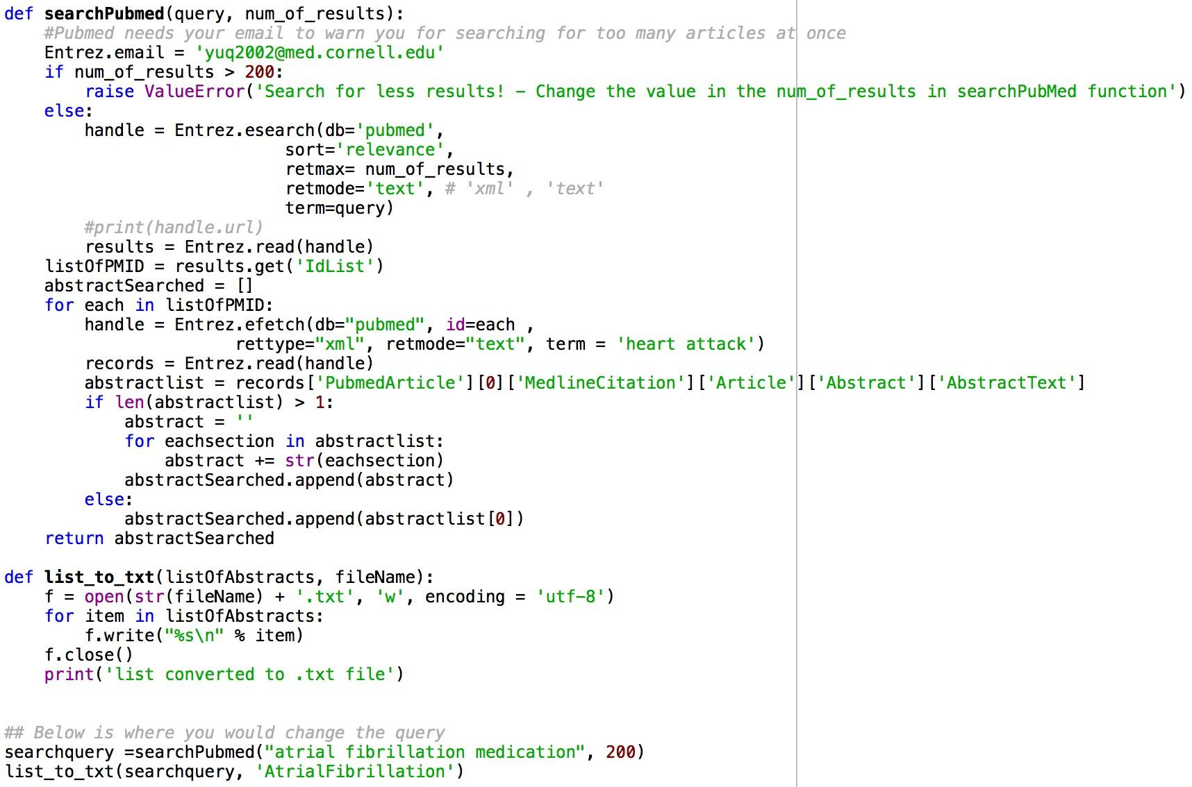
Implementation: TFIDF
- Extract treatment information from PubMed:
Three text files contain 200 abstracts for disease treatment related papers for top three diseases respectively are generated
Notes:
We used this searchPubmed code three times with different searching terms. Three text files contain 200 abstracts for disease treatment related papers for top three diseases respectively are generated. We will do tfidf based on these three documents.

Slide 17
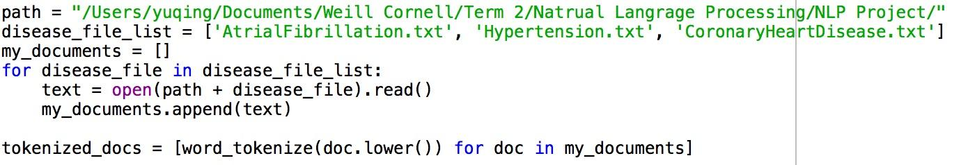
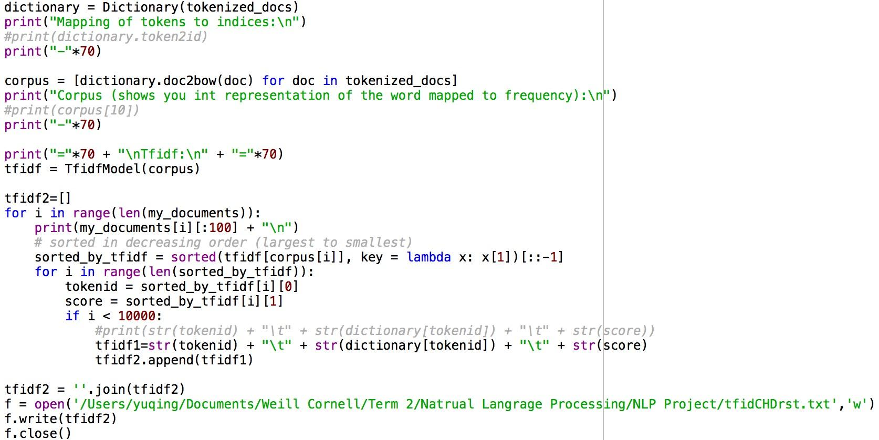
Implementation: TFIDF
Calculate the TFIDF for each word in the documents
Output the TFIDF result to a txt file
Search our medication terms to find corresponding TFIDF for each of three documents

Slide 18
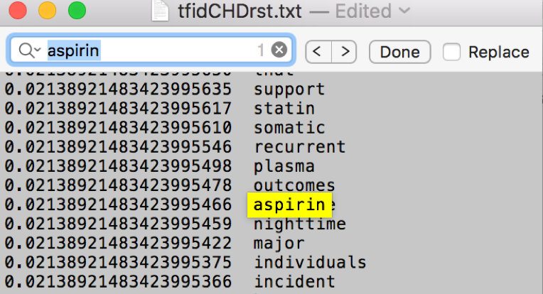
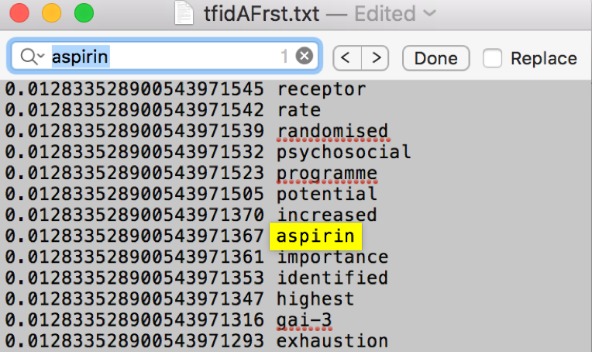
Implementation: TFIDF
Example of comparason:
To find which disease is "Aspirin" for
TFIDF in CAD: 0.0214
TFIDF in AF: 0.0128
TFIDF in HPT: none
Result: Aspirin is used for Coronary Artery Disease and Atrial Fibrillation, but not for Hypertension

Slide 19
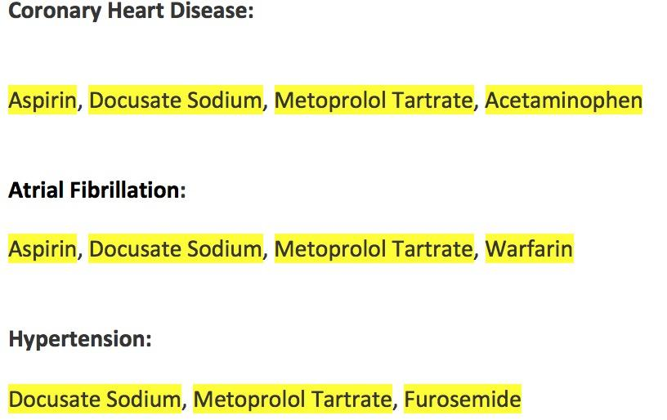
Results: TFIDF
Common medications are linked to three diseases as:
Notes:
Another method we considered about is the Clustering with k-means.
However, the problem is that from annotation we found that a lot of patients have several diseases instead of one, so the result could be biased and there will be missing of information. So we did not choose that one

Slide 20
Method selection & Combination
The final results are selected based on the precisions of results from two methods compared with annotation, literature research, and consultation with medical specialist.
Coronary Artery Disease:
Aspirin, Docusate Sodium, Metoprolol Tartrate, Acetaminophen
Atrial Fibrillation:
Aspirin, Docusate Sodium, Metoprolol Tartrate, Warfarin, Metoprolol succinate
Hypertension:
Aspirin, Docusate Sodium, Metoprolol Tartrate, Furosemide

Slide 21
Conclusion
Found that that Coronary Artery Disease, Hypertension, and Atrial Fibrillation are most common diseases
Coronary Artery Disease: Aspirin, Docusate Sodium, Metoprolol Tartrate, Acetaminophen
Atrial Fibrillation: Aspirin, Docusate Sodium, Metoprolol Tartrate, Warfarin, Metoprolol succinate
Hypertension: Aspirin, Docusate Sodium, Metoprolol Tartrate, Furosemide
Studies show lowering helps prevents stroke, heart attacks and kidney problems
Very Similar word counts for each medication
Diagnoses are closley related, which means high chance to erupt simultaneously

Slide 22
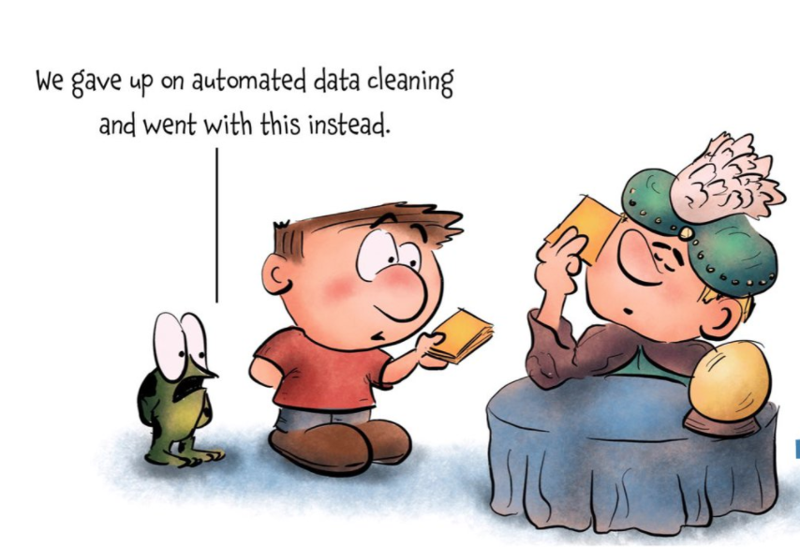

Slide 23
References
Johnson, A. E. W. et al. MIMIC-III, a freely accessible critical care database. Sci. Data 3:160035 doi: 10.1038/sdata.2016.35 (2016)
Kaplan, D., Berkman, B. and Fitzdale, H. (2016). The Elderly Living Alone. [online] Merck Manual. Available at: https://www.merckmanuals.com/professional/geriatrics/social-issues-in-the-elderly/the-elderly-living-alone [Accessed Aug. 2016].
Ghassemi, M., Richter, S., Eche, I., Chen, T., Danziger, J. and Celi, L. (2018). A data-driven approach to optimized medication dosing: a focus on heparin.
Physionet.org. (2016). The MIMIC-III Clinical Database. [online] Available at: https://physionet.org/physiobank/database/mimic3cdb/

